Slide 1
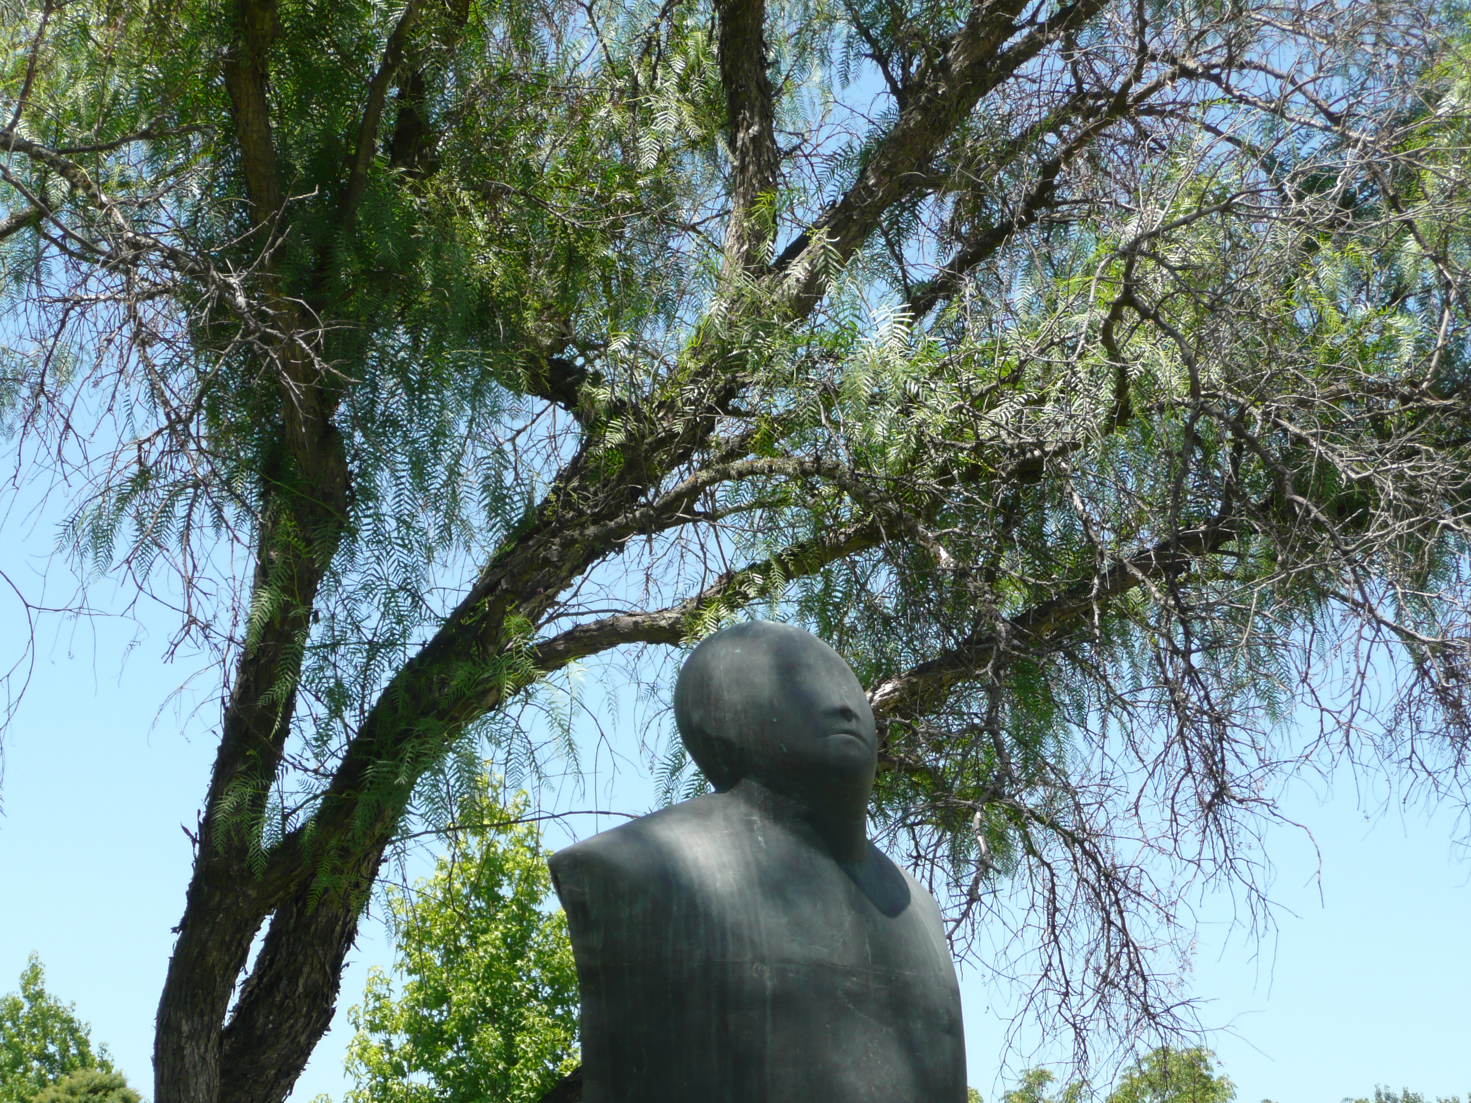
Inclusión, Equidad, y Diversidad
Conferencia CUP
Santiago, 15 de diciembre de 2022
,

Slide 2
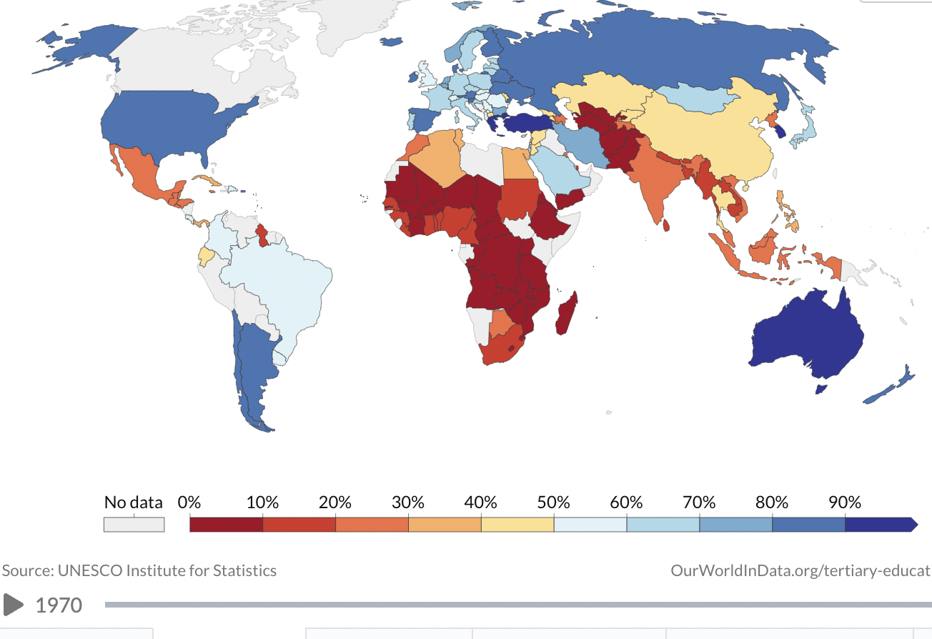
Notes:
The world of tertiary education has changed so much since the days of the first medieval universities in North Africa and Europe. According to UNESCO data, our planet counts today more than 220 million students enrolled in about 20,000 officially recognized institutions. However, in spite of this impressive expansion, disparities in access and success have prevailed. Sub-Sahara Africa’s tertiary education enrollment rate is less than 10%.

Slide 3

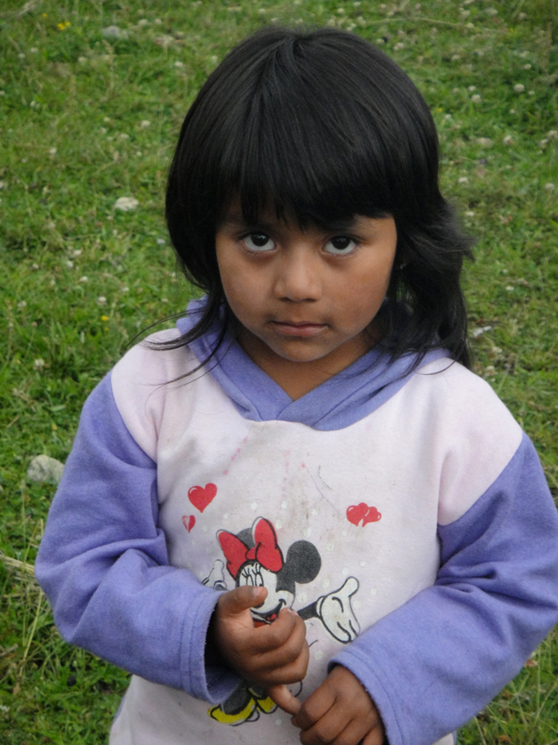

Slide 4
El Imperativo de la Equidad
Justicia Social
Notes:
European countries are losing hundreds of millions of Euros annually in productivity and in fiscal contributions to the governments.
o Lower bound estimates of annual productivity losses range from 231 million Euro in Serbia, 367 million Euro in the Czech Republic, 526 million Euro in Bulgaria, to 887 million Euro in Romania.
o Lower bound annual fiscal losses range from 58 million Euro in Serbia, 202 million Euro in Romania, 233 million Euro in the Czech Republic, and 370 million Euros in Bulgaria.
o Using other Roma population estimates (UNDP, 2006), the economic losses for the four countries combined are as much as 5.7 billion Euros annually, and the fiscal losses 2 billion Euros annually.

Slide 5
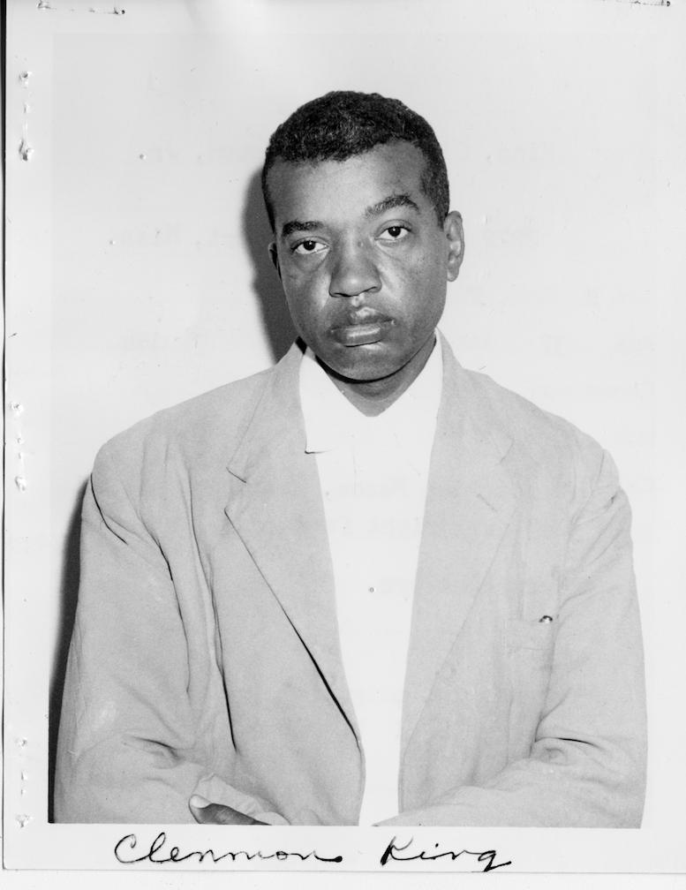
Notes:
Clennon King, un estudiante negro que se postuló para la Universidad de Mississippi en 1958, fue internado a la fuerza en un manicomio. El presidente de la Corte dictaminó que una persona negra seguramente debe estar loca para pensar que podría ser admitida en la Universidad de Mississippi.

Slide 6
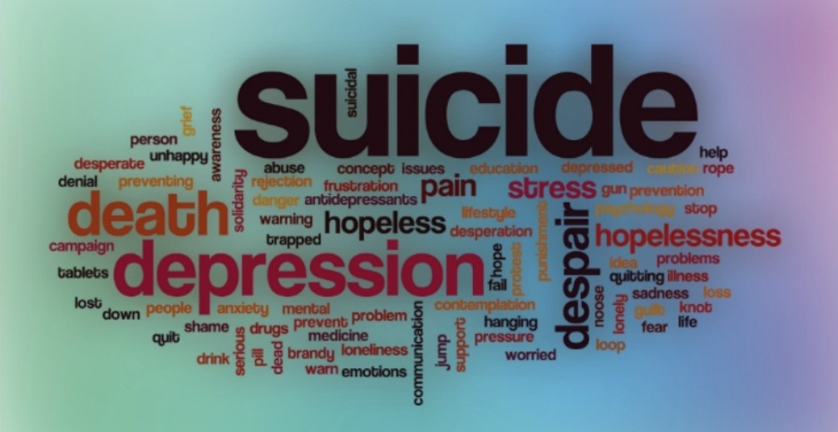

Slide 7
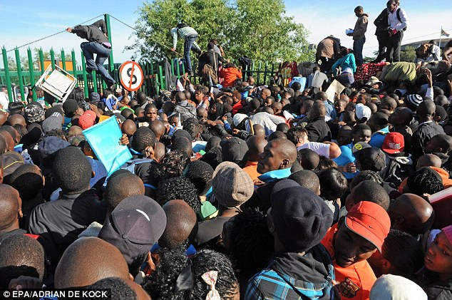

Slide 8
El Imperativo de la Equidad
Justicia Social
Desperdicio de Talento
Notes:
European countries are losing hundreds of millions of Euros annually in productivity and in fiscal contributions to the governments.
o Lower bound estimates of annual productivity losses range from 231 million Euro in Serbia, 367 million Euro in the Czech Republic, 526 million Euro in Bulgaria, to 887 million Euro in Romania.
o Lower bound annual fiscal losses range from 58 million Euro in Serbia, 202 million Euro in Romania, 233 million Euro in the Czech Republic, and 370 million Euros in Bulgaria.
o Using other Roma population estimates (UNDP, 2006), the economic losses for the four countries combined are as much as 5.7 billion Euros annually, and the fiscal losses 2 billion Euros annually.

Slide 9

¿Cuántas niñas talentosas se pierden?

Slide 10

Un genio en cada uno de nosotros?

Slide 11
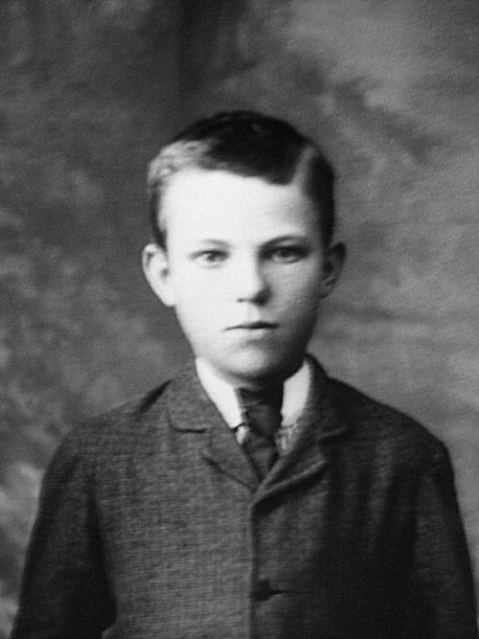
Notes:
a New Zealand-born British chemist and physicist who became known as the father of nuclear physics.^{[1]} In early work he discovered the concept of radioactive half life, proved that radioactivity involved the transmutation of one chemical element to another, and also differentiated and named alpha and beta radiation. This work was done at McGill University in Canada. It is the basis for the Nobel Prize in Chemistry he was awarded in 1908 "for his investigations into the disintegration of the elements, and the chemistry of radioactive substances".^{[2]}
Ernest Rutherford was the son of James Rutherford, a farmer, and his wife Martha Thompson, originally from Hornchurch, Essex, England.^{[4]} James had emigrated to New Zealand from Perth, Scotland, "to raise a little flax and a lot of children". Ernest was born at Spring Grove (now Brightwater), near Nelson, New Zealand. His first name was mistakenly spelled Earnest when his birth was registered.^{[5]}
He studied at Havelock School and then Nelson College and won a scholarship to study at Canterbury College, University of New Zealand where he was president of the debating society, among other things. After gaining his BA, MA and BSc, and doing two years of research at the forefront of electrical technology, in 1895 Rutherford travelled to England for postgraduate study at the Cavendish Laboratory, University of Cambridge (1895–1898),^{[6]} and he briefly held the world record for the distance over which electromagnetic waves could be detected.
1908 Nobel Prize of Chemistry

Slide 12
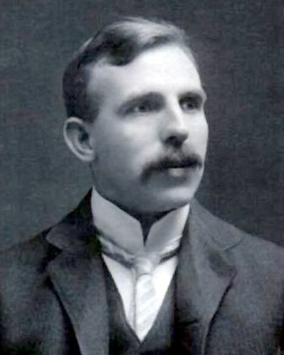
Lord Rutherford
Notes:
a New Zealand-born British chemist and physicist who became known as the father of nuclear physics.^{[1]} In early work he discovered the concept of radioactive half life, proved that radioactivity involved the transmutation of one chemical element to another, and also differentiated and named alpha and beta radiation. This work was done at McGill University in Canada. It is the basis for the Nobel Prize in Chemistry he was awarded in 1908 "for his investigations into the disintegration of the elements, and the chemistry of radioactive substances".^{[2]}
Ernest Rutherford was the son of James Rutherford, a farmer, and his wife Martha Thompson, originally from Hornchurch, Essex, England.^{[4]} James had emigrated to New Zealand from Perth, Scotland, "to raise a little flax and a lot of children". Ernest was born at Spring Grove (now Brightwater), near Nelson, New Zealand. His first name was mistakenly spelled Earnest when his birth was registered.^{[5]}
He studied at Havelock School and then Nelson College and won a scholarship to study at Canterbury College, University of New Zealand where he was president of the debating society, among other things. After gaining his BA, MA and BSc, and doing two years of research at the forefront of electrical technology, in 1895 Rutherford travelled to England for postgraduate study at the Cavendish Laboratory, University of Cambridge (1895–1898),^{[6]} and he briefly held the world record for the distance over which electromagnetic waves could be detected.
1908 Nobel Prize of Chemistry

Slide 13
Premisas
Equidad = proveer igualdad de oportunidades para el acceso y éxito en la educación superior
Circunstancias que van más allá del control del individuo no deberían influir en las oportunidades de las personas
Notes:
such as birth place, gender, ethnicity, religion, language, disability, or parental income

Slide 14
Esquema
Alcance de las disparidades
Principales causas de la desigualdad
Impacto del Covid
Políticas de promoción de la equidad

Slide 15
Grupos de atención en materia de equidad
Nivel socio-económico / ubicación geográfica / rural / áreas remotas
Género
Grupos minoritarios (Etnias, Afrodescendientes, LGBTI)
Estudiantes con necesidades especiales
Interseccionalidad
Notes:
In Australia and the United States, for instance, 13% and 6% of households do not have a high-speed connection, according to the World Economic Forum. In the latter country, one-third of low-income people are not connected. In France, a survey carried out in June 2020 found that at least 50,000 students had dropped out for lack of connection, equivalent to 4% of the total student population (Haberbush, 2020). Minority students have encountered similar difficulties in Canada.
The African University Association already has signaled that, among the 700 universities operating in Sub-Saharan Africa, very few were well prepared and sufficiently equipped to deliver their programs online. A survey conducted by the Association of Commonwealth Universities in May 2020 revealed that, among the 259 respondents (academics and students) from 33 countries, 55% indicated that they did not have access to broadband, and as expected the probability of having access to broadband was proportional to the level of income (ACU, 2020).
Interviews with AAU officials.
UNESCO’S Regional Office for Latin America and the Caribbean estimates that about 30% of students in the region were unable to participate in online education for lack of computer and/or adequate internet connection

Slide 16
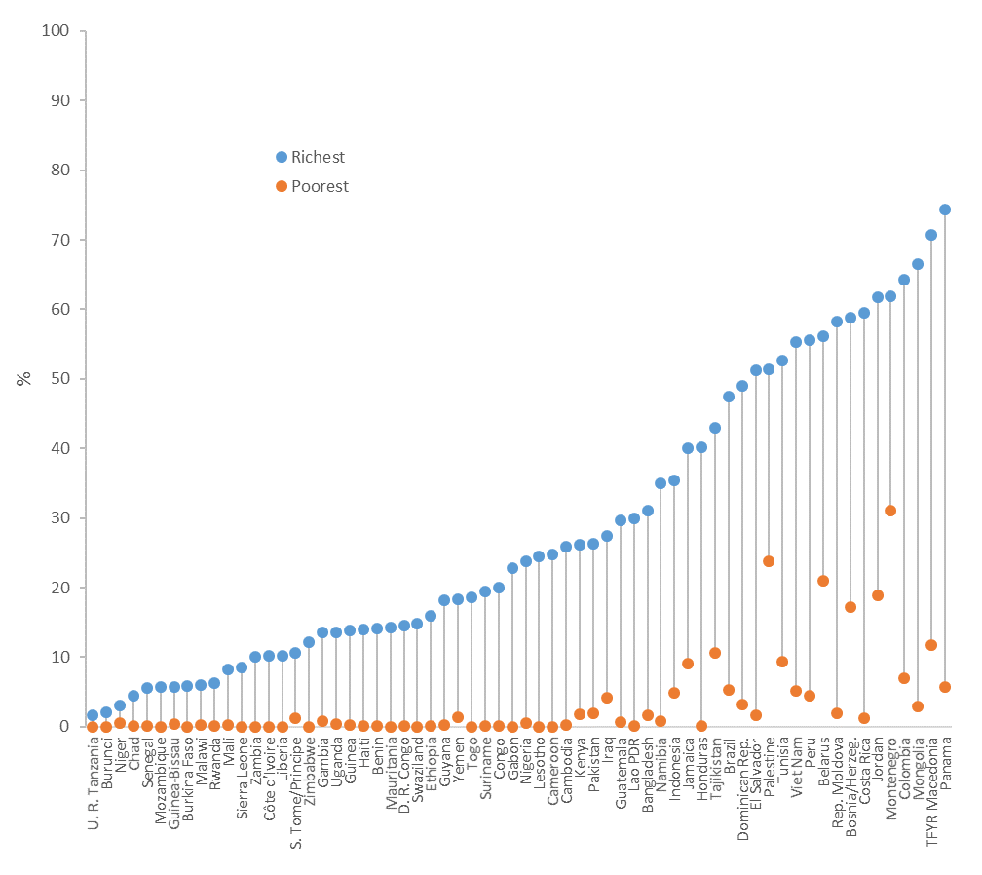

Slide 17
Grupos de atención en materia de equidad
Nivel socio-económico / ubicación geográfica / rural / áreas remotas
Género
Notes:
In Australia and the United States, for instance, 13% and 6% of households do not have a high-speed connection, according to the World Economic Forum. In the latter country, one-third of low-income people are not connected. In France, a survey carried out in June 2020 found that at least 50,000 students had dropped out for lack of connection, equivalent to 4% of the total student population (Haberbush, 2020). Minority students have encountered similar difficulties in Canada.
The African University Association already has signaled that, among the 700 universities operating in Sub-Saharan Africa, very few were well prepared and sufficiently equipped to deliver their programs online. A survey conducted by the Association of Commonwealth Universities in May 2020 revealed that, among the 259 respondents (academics and students) from 33 countries, 55% indicated that they did not have access to broadband, and as expected the probability of having access to broadband was proportional to the level of income (ACU, 2020).
Interviews with AAU officials.
UNESCO’S Regional Office for Latin America and the Caribbean estimates that about 30% of students in the region were unable to participate in online education for lack of computer and/or adequate internet connection

Slide 18
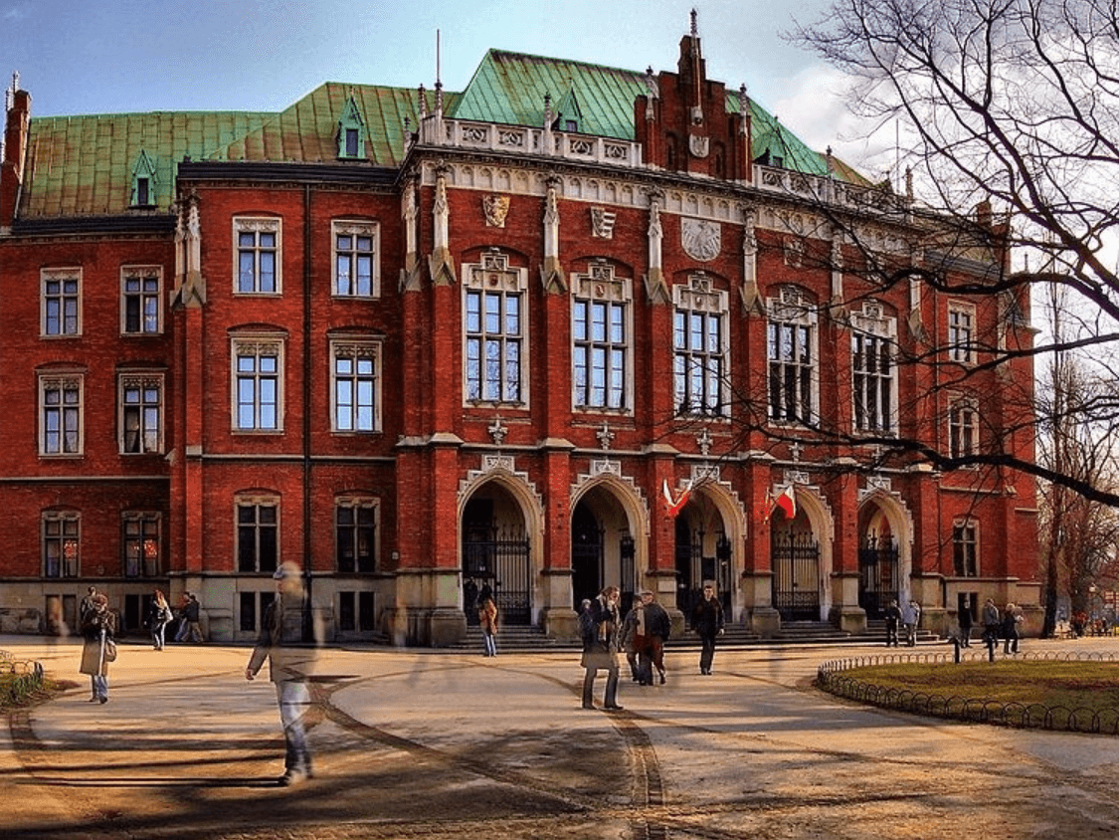
Notes:
Maria Salomea Skłodowska
University of Krakov

Slide 19
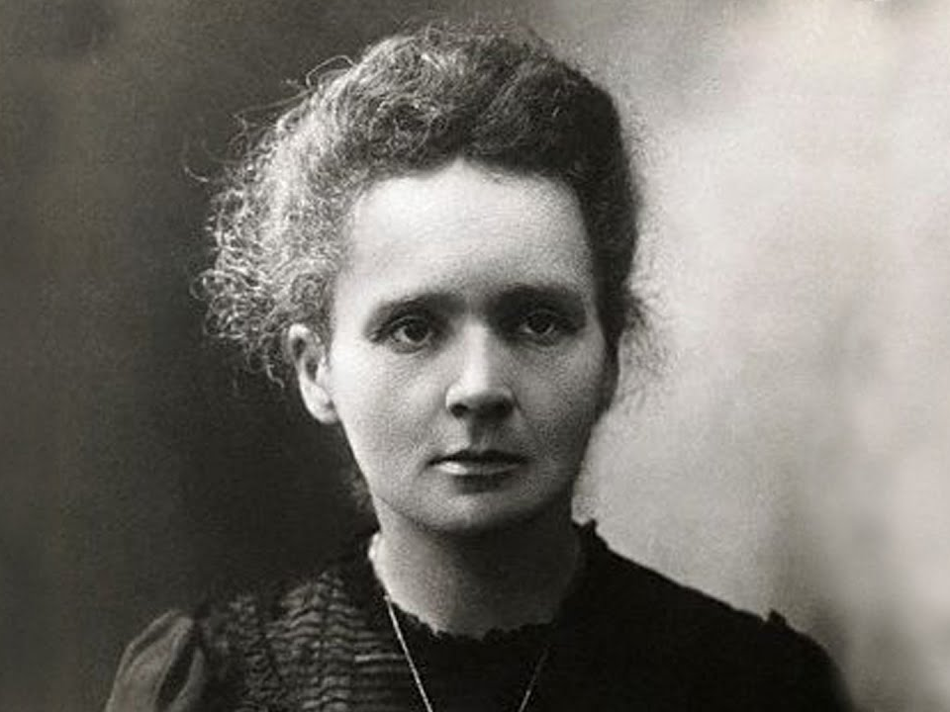
Notes:
Nothing in life is to be feared. It is only to be understood.

Slide 20
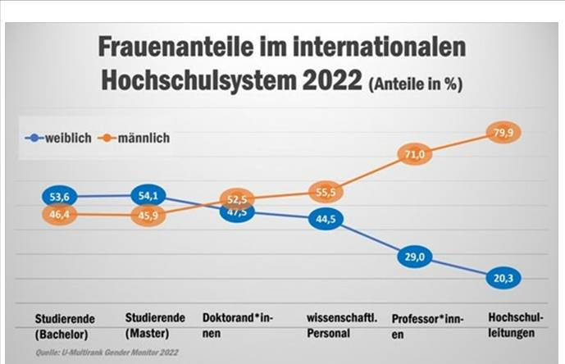

Slide 21
Tasa de matricula por género en la India
Notes:
Enrollment rate

Slide 22
Nuevas categorías de grupos de equidad dentro de la categoría minoritaria
Grupos | Ejemplo de Países
Primera Generación de Estudiantes | Australia, Estados Unidos
LGBTQIA | Brasil, Colombia
Víctimas de abuso / violencia sexual | Colombia, Ecuador, España
Migrantes Deportados | Ecuador, México
Hijos de Veteranos e Inválidos de Guerra | México, Rusia, Vietnam
Refugiados | Australia, Colombia, Nueva Zelandia
Hijos de familia militar | Inglaterra
Desplazados internos como resultado de conflicto, guerra civil o desastres naturales | Colombia, Georgia
Desmovilizados de la guerrilla y paramilitares | Colombia
Estudiantes que no hablan la lengua del país | Dinamarca
Estudiantes que requieren cuidado especial, huérfanos, jóvenes sin familia | Austria, Inglaterra, Georgia Kyrgyzstan, Rusia, Escocia
Madres Solteras | Ecuador
Familias con más de tres hijos | Georgia, Corea del Sur
Hijos de padres deportados durante la era Soviética | Georgia
Prisioneros, ex-prisioneros | Venezuela, Wales
Estudiantes de territorios ocupados | Georgia

Slide 23
Tasa de Graduación en Rumania

Slide 24
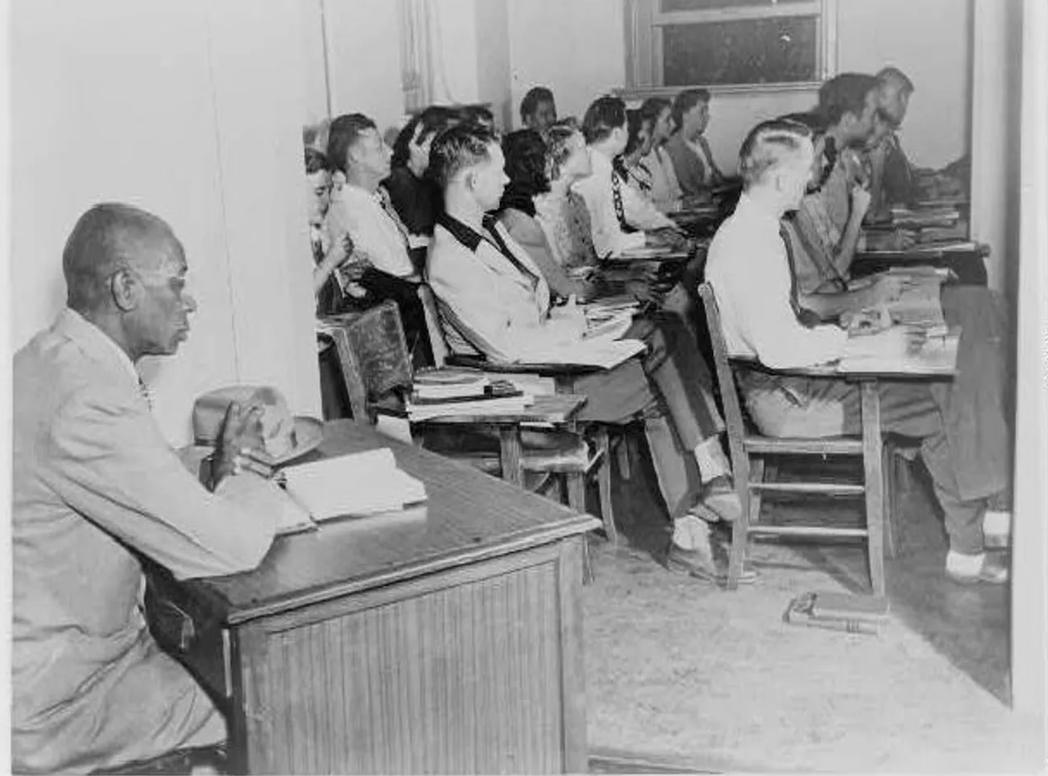
Notes:
The picture below shows George McLaurin sitting in the closet in Carnegie Hall, Room 104, the spot he was forced to occupy, separate from his peers in 1948, even after he had won admission to the university. For two years he took his classes from that closet at University of Oklahoma, the only African American student on a campus of 12,174.

Slide 25
Disparidades en EEUU
Tasa de graduación a final de la secundaria
Indígenas 74.3%
Afro-Americanos 78.6%
Blancos 89.6%
Deserción en la educación superior
Afro-Americanos 58%
Blancos 40%

Slide 26
Interseccionalidad & efectos acumulativos
Categoria | Tasa de Graduación
Ningún factor de desventaja | 71,9%
Ingreso bajo/ Indígena / Regional / Descapacitado | 65,5%
Dos factores de desventaja | 59,8%
Tres factores de desventaja | 47,8%
Los cuatro factores | 34,8%

Slide 27
Impacto en las perspectivas de empleo
Categoria | Tasa de Empleo
Ningún factor de desventaja | 84%
Un factor de desventaja | 79%
Dos o más factores de desventaja | 70%

Slide 28
Esquema
Alcance de las disparidades
Principales causas de la desigualdad

Slide 29
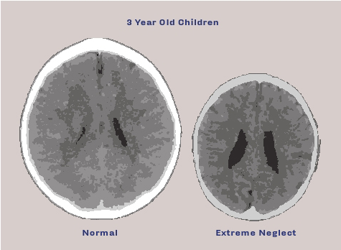
Notes:
Abnormal brain development following sensory neglect in early childhood. The scan on the left is from a normal three-year old child with an average head size (50% percentile). On the right is a child with severe sensory neglect. This child’s brain is significantly smaller and has enlarged ventricles and cortical atrophy. Nature vs nurture

Slide 30
Factores Principales
Resultados de la educación primaria y secundaria
Barreras financieras (cobro de matrícula, gastos de manutención, costo de oportunidad, perspectivas de empleo)
Obstáculos no financieros
Capital cultural
Información
Motivación
Preparación académica

Slide 31
Efectos de la identidad de casta en el rendimiento académico

Slide 32
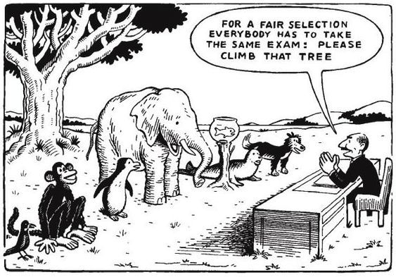

Slide 33
U. de São Paulo
Notes:
no pago de matrícula
84% de los candidatos vienen de colegios estatales
representan solamente el 30% de los nuevos estudiantes
en la Facultad de Medicina, 3 de los 180 nuevos estudiantes

Slide 34
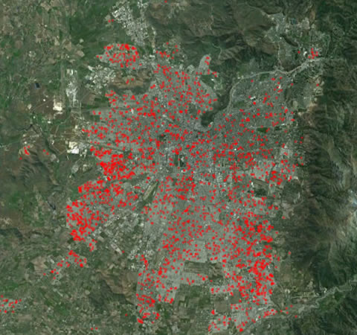
Universidad de Santiago de Chile

Slide 35
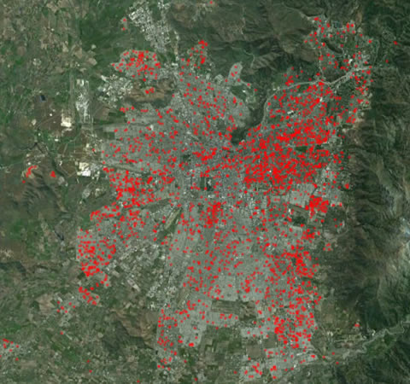
University of Chile

Slide 36
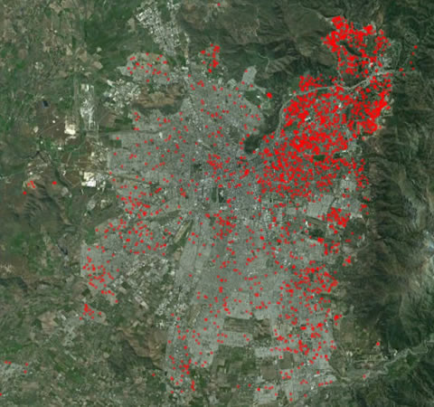
Catholic University of Chile

Slide 37
Esquema
Alcance de las disparidades
Principales causas de la desigualdad
Impacto del Covid

Slide 38
Elijen a sus papas cuidadosamente

Slide 39
Impacto del Covid-19
Factores de preparación | Países de Ato Ingreso | Países de Ingreso Medio | Países de Bajo Ingreso
Dificultades financieras para el sostenimiento de los estudiantes | ✓ | ✓✓ | ✓✓✓
Falta de equipos y conexión a internet | ✓✓ | ✓✓ | ✓✓✓
Dificultades académicas | ✓ | ✓✓ | ✓✓
Estres emocional | ✓✓ | ✓✓ | ✓✓
Riesgo de deserción | ✓ | ✓✓ | ✓✓

Slide 41
Esquema
Alcance de las disparidades
Principales causas de la desigualdad
Impacto del Covid
Políticas de promoción de la equidad

Slide 42
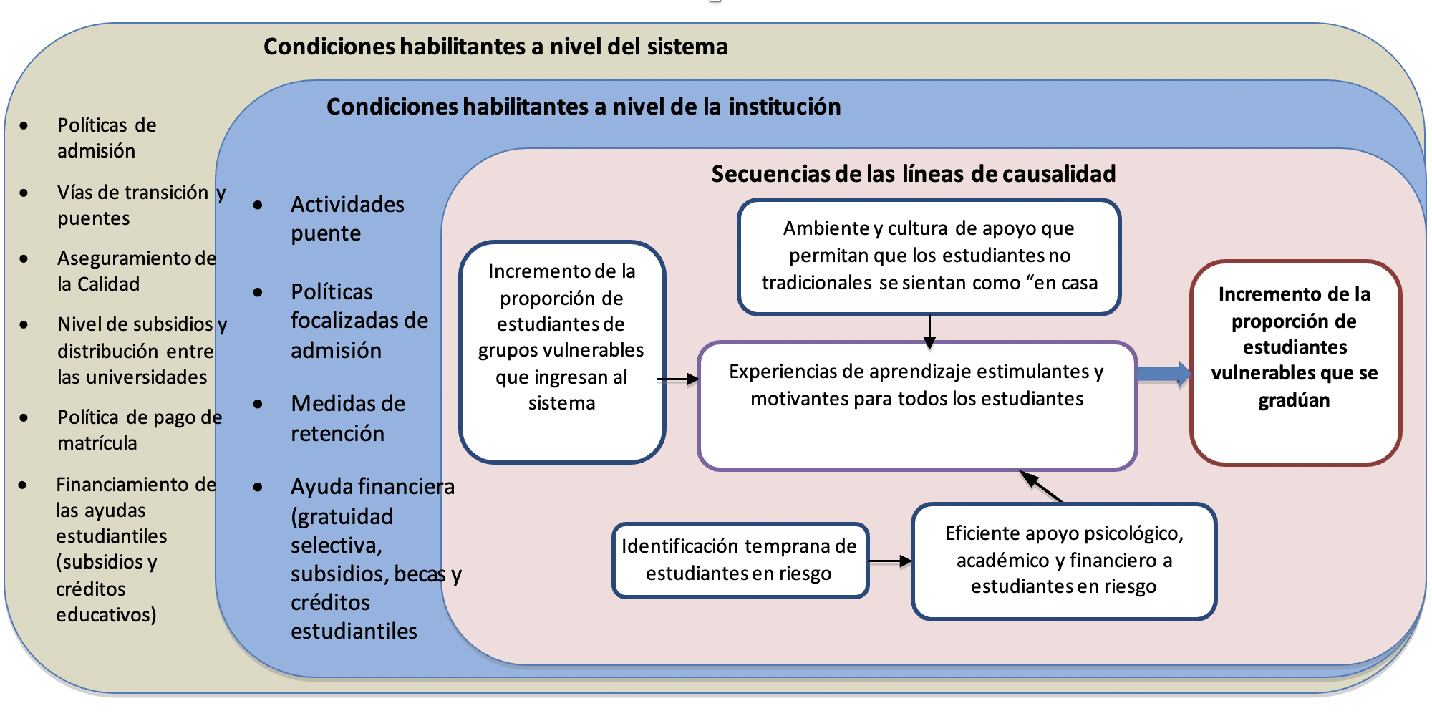
Teoria de Cambio

Slide 43
Políticas de Equidad a Nivel Nacional
Políticas de admisión
Caminos y puentes
Aseguramiento de la calidad
Nivel de financiamento público y mecanismos de asignación
Política de pago de matricula
Apoyo financiero a los estudiantes

Slide 44
Si en algunos estados de los Estados Unidos las instituciones de educación superior también son "gratuitas", eso solo significa de hecho sufragar el costo de la educación de las clases altas con los ingresos fiscales generales.
Karl Marx y Friedrich Engels, 1875

Slide 45
Cobro de Matrícula en las IES Públicas
Impacto Modalidad de Costos Compartidos | Sostenibilidad Financiera | Equidad
Educación Superior gratuita para todos | Muy Costoso | Los estudiantes ricos son probablemente los más beneficiados
Pago de Matrícula para todos | Menos demanda de recursos fiscales | Equitativo si la ayuda financiera esta disponible
Pago de Matrícula solo para Estudiantes “Pararles”? | Menos demanda de recursos fiscales | Los estudiantes ricos son probablemente los más beneficiados
Educación Superior gratuita para estudiantes focalizados | Costoso | Potencialmente más equitativo

Slide 46
Gratuidad Con Enfoque a los Más Pobres (Targeted Free Tuition)
Chile, Colombia, Sur África, Italia, Japón, algunos estados en EEUU, Filipinas

Slide 48
ICETEX
Primera agencia de crédito educativo en el mundo
Mejora impresionante en la decada de los 2.000
Ampliación de la cobertura
Medidas no financieras
Disminución de la deserción
Métodos modernos de gestión
Ser Pilo Paga
Nuevo impulso de transformación hoy en día

Slide 49
Australia
Universal
Cobranza a través del sistema de impuestos
Equitativo (0 a 8% del ingreso de los egresados)
Eficiente: todos pagan
Sostenible

Slide 50
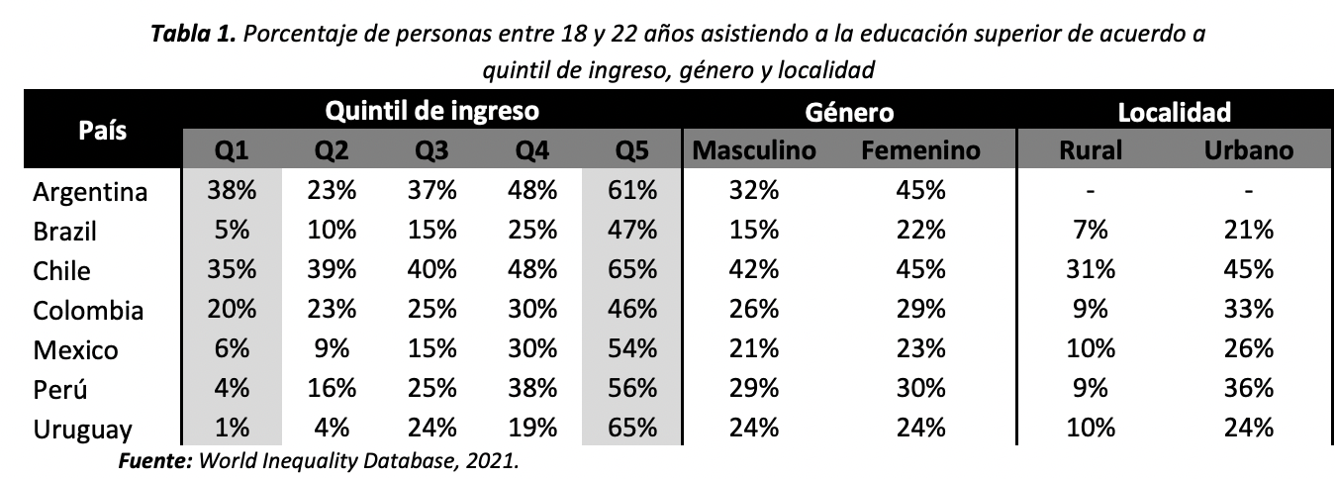

Slide 51
Índice de Disparidad

Slide 52
Políticas de Equidad a Nivel de las Instituciones
Programas de alcanze y puentes
Discriminación positiva (Unicamp, PACES)
Retención
Apoyo financiero
Notes:
In Australia and the United States, for instance, 13% and 6% of households do not have a high-speed connection, according to the World Economic Forum. In the latter country, one-third of low-income people are not connected. In France, a survey carried out in June 2020 found that at least 50,000 students had dropped out for lack of connection, equivalent to 4% of the total student population (Haberbush, 2020). Minority students have encountered similar difficulties in Canada.
The African University Association already has signaled that, among the 700 universities operating in Sub-Saharan Africa, very few were well prepared and sufficiently equipped to deliver their programs online. A survey conducted by the Association of Commonwealth Universities in May 2020 revealed that, among the 259 respondents (academics and students) from 33 countries, 55% indicated that they did not have access to broadband, and as expected the probability of having access to broadband was proportional to the level of income (ACU, 2020).
Interviews with AAU officials.
UNESCO’S Regional Office for Latin America and the Caribbean estimates that about 30% of students in the region were unable to participate in online education for lack of computer and/or adequate internet connection
Brazil: 1.2 million households without Internet, 17% of students do not have a computer or a tablet, can access the internet only using their cellular phone

Slide 53
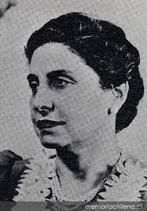
Ernestina Pérez Barahona
Notes:
Gender segregation at Humboldt University
http://www.heroinas.net/2017/01/ernestina-perez-barahona-primera.html
https://en.wikipedia.org/wiki/Ernestina_P%C3%A9rez_Barahona
Primera mujer ginecóloga de Chile: Ernestina Pérez
Ernestina Pérez Barahona (Valparaíso, 8 de agosto de 1865 - 1951) fue una médica y activista feminista chilena conocida por ser una de las primeras mujeres estudiantes de medicina de la Universidad de Chile y la segunda médica de América Latina tras titularse días después que Eloísa Díaz Insunza, también chilena.
Ernestina Pérez Barahona nació el año 1868 en Valparaíso. En 1887, se recibió de médico de la Facultad de Medicina de la Universidad de Chile a los 21 años, sólo siete días después que Eloísa Díaz.
Luego de recibir el título universitario, viajó a especializarse en ginecología a Alemania con una beca entregada por el Estado de Chile. En el país europeo no era aceptada la educación universitaria para mujeres en Medicina, por lo que se instaló un biombo (screen) en las salas de clases para separarla de los hombres; aquí se transformó en el primer sudamericano en ser aceptado en la Academia de Medicina de Berlín, y la primera mujer en estudiar una carrera asociada a esta disciplina en la Universidad de Berlín. De hecho, obligó a un cambio en su reglamento para que una mujer pudiera ingresar a sus aulas a estudiar esta carrera. se especializó en ginecología, materia en la cual destaca su obra Compendio de Ginecología y la puericultura, a través de conferencias y elaboración de manuales.
http://www.memoriachilena.cl/602/w3-article-96244.html

Slide 54
¿Qué funciona bien?
Visión y estrategia claras (Wollongong, Uniminuto)
Vice-rector de equidad y departamento dedicado (Wits)
Alianzas con autoridades locales y empresas (Antioquia)
Cultura institucional incluyente para estudiantes de primera generación (Australia)
Adaptación de modelos institucionales por las autoridades nacionales (Uniminuto, Unicamp, USACH)
Notes:
Australia: pioneer in the design and implementation of a national income contingent loan scheme; Australia was identified in the 2018 Lumina study as one of the world leaders in terms of comprehensive equity policies.
Austria: generous social policies; one of the few Western European countries that experimented with tuition fees for a few years in the last decade.
Colombia: pioneer in the establishment of the first student loan agency in the world; long-standing tradition of equity promotion policies at the national and regional levels.
South Africa: comprehensive efforts to eradicate the adverse legacy of the apartheid regime; recently pioneer in introducing a targeted free tuition approach.
Vietnam: one of the few socialist countries with universal tuition fees in its public universities; affirmative action policies to support students from ethnic minorities.

Slide 55
Benchmarking

Slide 56
Los Campeones
Australia, Cuba, Inglaterra, Irlanda, Nueva Zelandia, y Escocía

Slide 57
Falta de estudios de impacto
Notes:
76 impact studies

Slide 58
Falta de información estadística
Grupos de Equidad | Número de Países
Genero | 47
Nivel Socio-Económico | 36
Origen Geográfico (Rural) | 33
Adultos/ Estudiantes Mayores | 33
Población con estatus de Refugiados | 32
Descapacitados | 31
Grupos Etnicos | 29
Idioma | 20
Grupos Indígenas | 16
Religión | 14
Otros | 14

Slide 59
Conclusión

Slide 60
Igualdad de Oportunidades
La impertinente cortesía de una invitación ofrecida a huéspedes indeseables,
en la certeza de que las circunstancias les impedirán aceptar.
Richard Tawney

Slide 61
Lecciones Aprendidas
Liderazgo nacional / visión / objetivos / instrumentos de política / gobernanza / recursos (alineados)
Continuidad de las políticas
Combinación de medidas financieras y no-monetarias
Combinación de medidas a nivel nacional e institucional
Importancia del monitoreo y de la evaluación
Necesidad de datos adecuados
Notes:
New educational model: innovative teaching and learning / blended / assessment
Collaborative: open education, open science and open publications
Business model that is shock resistant
Seneca quote

Slide 62

La diversidad es una realidad.
La equidad es una elección.
La inclusión es una acción.
El sentido de pertenencia es un resultado.

Slide 63
